Slide 1
Numerical
Differentiation
Course : MATH6183 – Scientific Computing
Year : 2021

Slide 2
Outlines
Finite Difference Approximations
Derivatives by Interpolation
Richardson Extrapolation

Slide 3

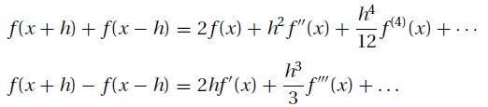
Finite Difference Approximations
The derivation of the finite difference approximations for the derivatives of f (x) is based on forward and backward Taylor series expansions of f (x) about x, such as
We also record the sums and differences of the series:

Slide 4


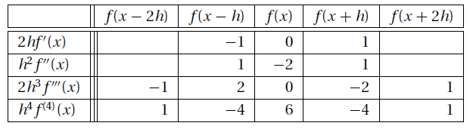
First Central Difference Approximations
The first central difference approximation for f’(x) and f’’(x):
Summary of coefficients of central finite difference approximations
of O(h²) in table below

Slide 5

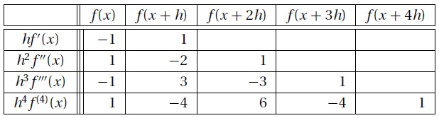
First Forward Difference Approximations
The first forward difference approximation
Summary of coefficients of forward finite difference approximations of O(h)

Slide 6

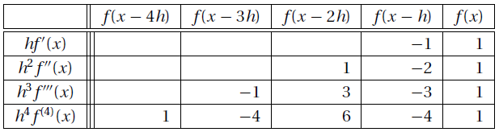
First Backward Difference Approximations
The first backward difference approximation
Summary of coefficients of backward finite difference approximations of O(h)

Slide 7

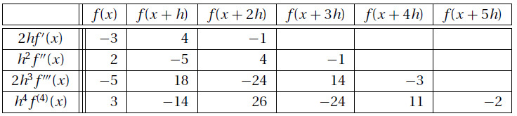
The Second Forward Difference Approximations
The Second Forward Difference Approximation
Summary of coefficients of forward finite difference approximations of O(h²)

Slide 8
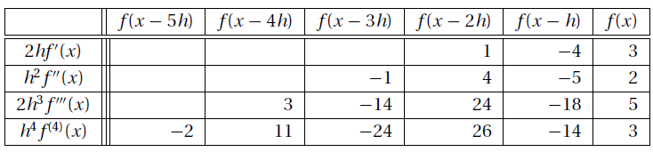
The Second Backward Difference Approximations
Summary of coefficients of backward finite difference approximations of O(h²)

Slide 9

Example
Given the evenly spaced data points
compute f ‘(x) and f ‘’(x) at x = 0 and 0.2 using finite difference approximations of O(h²).
Solution
We use finite difference approximations of O(h2). From the forward difference tables, we get

Slide 10
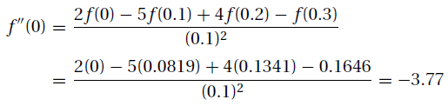
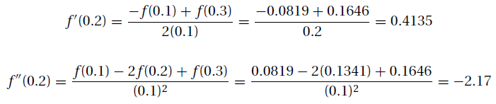
Example
The central difference approximations in Table yield :

Slide 11


Richardson Extrapolation
Richardson extrapolation is a simple method for boosting the accuracy of certain numerical procedures, including finite difference approximations.
The Richardson extrapolation formula is
It is common practice to use h₂ = h₁/2, in which case Equation. becomes

Slide 12
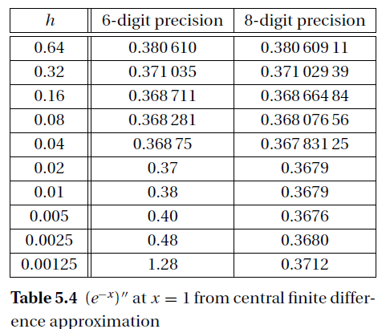
Richardson Extrapolation
Tabel 1. Richardson extrapolation
Let us illustrate Richardson
extrapolation by applying
it to the central finite difference approximation
of (e^{−x} )’’ at x = 1.

Slide 13
Richardson Extrapolation
Because the extrapolation works only on the truncation error, we
must confine h to values that produce negligible round-off. In Table 1 we have
The truncation error in central difference approximation is
E(h) = O(h²) = c₁h² +c₂h⁴ + c₃h⁶ + . . ..
Therefore, we can eliminate the first (dominant) error term if we substitute p = 2 and h₁ = 0.64 in The Richardson extrapolation formula. The result is
which is an approximation of (e^{−x})’’ with the error O(h⁴).
*Note that it is as accurate as the best result obtained with eight-digit computations in Table 1.

Slide 14
Example 2
Use the data in Example 1 to compute f‘(0) as accurately as you can
Solution
One solution is to apply Richardson extrapolation to finite difference approximations. We start with two forward difference approximations of O(h²) for f(0): one using h = 0.2 and the other one h = 0.1. Referring to summary of coefficients of forward finite difference approximations of O(h²), we get

Slide 15
Example 2
Recall that the error in both approximations is of the form
E(h) = c₁h² + c₂h⁴ +c₃h⁶ + . . .
We can now use Richardson extrapolation, to eliminate the dominant error term. With p = 2 we obtain
which is a finite difference approximation of O(h⁴).

Slide 16

Exercise
Use finite difference approximations of O(h2) to compute f ‘(2.36) and f’’ (2.36) from the data

Slide 17
Derivatives by Extrapolation
If f(x) is given as a set of discrete data points, interpolation can be a very effective means of computing its derivatives.
The idea is to approximate the derivative of f(x) by the derivative of the interpolant. This method is particularly useful if the data points are located at uneven intervals of x, when the finite difference approximations listed in the last section are not applicable.

Slide 18
Polynomial Interpolant
The idea here is simple: fit the polynomial of degree n
through n + 1 data points and then evaluate its derivatives at the given x.
For evenly spaced data points, polynomial interpolation and finite difference approximations produce identical results. In fact, the finite difference formulas are equivalent to polynomial interpolation.

Slide 19


Example 3
Given the data
Compute f ‘(2) and f ‘’(2) using polynomial interpolation over three nearest neighbor points.
Solution
The interpolant is P₂(x) = a₀ +a₁x +a₂x² passing through the points at x = 1.9, 2.1, and 2.4. The normal equations of the least-squares fit are

Slide 20



Example 3
After substituting the data, we get
which yields
The derivatives of the interpolant are P’₂(x) = a₁ + 2a₂x and P”₂(x) = 2a₂. Therefore,

Slide 21
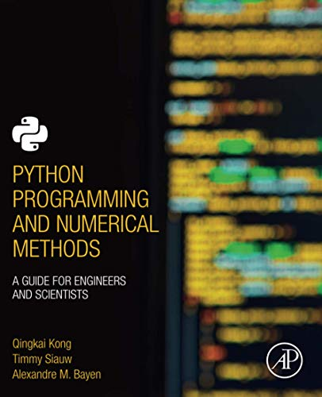
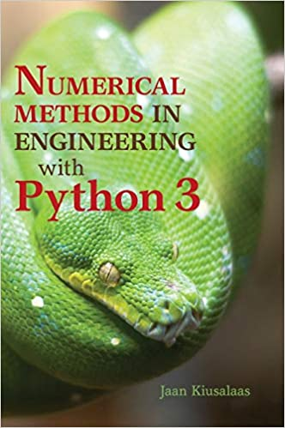
These slides have been adapted from: Kong, Q., Siauw, T., & Bayen, A. M. (2021). Python Programming and Numerical Methods: A Guide for Engineers and Scientists. Academic Press. ISBN: 978-0-12-819549-9 Kiusalaas, J. (2013). Numerical Methods in Engineering with Python 3. United Kingdom: Cambridge University Press. ISBN:9781107033856 additional materials Chapra, S.C (2015). Numerical Methods for Engineers. 6st Edition. McGraw-Hill Companies, Inc . New York. ISBN. 978-981-4670-87
Acknowledgement

